Slide 1
Cloud-native applications
Tobias Lolax – Active Solution
Chris Klug – Active Solution

Slide 2

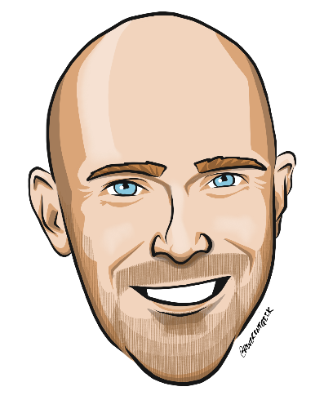
Who are we?
Tobias Lolax
Chris Klug

Slide 3
IMPORTANT INFO
Notes:
viktigt och bra om de ställer frågor och är interaktiva med oss också
Reminder: there are no stupid questions, only stupid answers and that’s why we are here! So do be afraid, just ask away
Whiteboarding not really useful when many people and remote. For company specific whiteboard feel free to reach out to us

Slide 4
What does ”cloud native” mean?
Notes:
Not just kubernetes and containers
TLDR: piece of software, designed to run in, and reap the benefits of ”the cloud”

Slide 5
Deployment Containers/PaaS/FaaS

Slide 6
Language Agnostic
Notes:
Mostly
Containers: pick the best tool for the job. GraphQL running on node, REST api written in C# and your batch job processor written in Rust
Azure functions: C#, F#, js, ts, powershell, python, java

Slide 7
(Platform Agnostic)
Notes:
Depends
Containers, then mostly

Slide 8
Resilient & Scalable
Notes:
built with resiliency and scalability in mind
validate? throw a chaos monkey into the ring

Slide 9
API-centric / Event Driven

Slide 10
Automated CI/CD/Testing Pipelines/Workflows/GitOps

Slide 11
Stateless / Stateful Clean separation
Notes:
Ties together with the scalability as well as resilience attribute.

Slide 12
Who are you?

Slide 13
Who are you?

Slide 14
Who are already using CI/CD pipelines today?
Notes:
Follow up: what about CI/CD for the infrastructure? Terraform, Pulumi, ARM templates...

Slide 15
Who are already familiar with containers?

Slide 16
Who are already running containers for dev/test workloads today?
Notes:
Follow up question/discussion: where are you running them?
Locally? Infrastructure on-prem? Already in the cloud?

Slide 17
Who are already running containers for production workloads today?

Slide 18
Who are planning to move to, or develop a cloud native solution?

Slide 19
Case study
Notes:
Discuss a fictive case based on real customer cases and design an architecture

Slide 20

Review a customer case study
bit.ly/aiw-cloudnative-case
Notes:
10 min att läsa texten

Slide 21
Customer situation
Fabrikam Medical Conferences provides conference web site services tailored to the medical community.
After starting with a few small conferences, they now have evolved into a well-known brand and handle over 100 conferences per year, and growing.

Slide 22
Customer situation
Each conference site has limited budget, but the conference owners have significant customization and change demands.
These changes can impact various aspects of the system from UI to back end, including conference registration and payment terms.

Slide 23
Customer situation
12 developers handle
Development
Testing
Deployment
Operational management of all customer sites
Due to customer demands, they have issues with the efficiency and reliability of their development and DevOps workflows.

Slide 24
Customer situation
The technology used is the MEAN stack
Mongo, Express, Angular, and Node.js
Web sites and APIs are built as microservices hosted on Linux servers.
The on-prem data backend is MongoDB; also running on a separate cluster of Linux servers.
There is relational data stored in PostgreSQL running on Linux servers.

Slide 25
Customer situation
Conference owners (“customers”) are considered “tenants”, and each tenant is treated as a unique deployment including:
Each tenant has a database in the MongoDB cluster with its own collections, and a database in PostgreSQL.
A copy of the most recent functional conference code base is taken and configured to point at the tenant database
Modifications are made to support the customer’s needs
The tenant’s code is deployed to a specific group of load balanced Linux server dedicated to one or more tenant.
Once the conference site is live, the inevitable requests for customizations to the deployment begins.

Slide 26
Customer situation
They are looking to achieve the following:
Reduce potential regressions introduced to functional tenant code when changes are made
Ideally, changes to individual areas should not require a full regression test of the site functionality
Reduce the time to onboard new tenants
Reduce overhead managing changes, and related deployments
Improve ability to roll back and recover post change
Increase visibility into system operations and health

Slide 27
Customer needs
Simplify new tenant deployment
Improve reliability of tenant updates
Choose a suitable container strategy on Azure
Migrate on-prem MongoDB to cloud without application changes
Migrate on-prem PostgreSQL to cloud
Continue to use Git repositories for source control
Look at alternatives for CICD

Slide 28
Solution design
Based on the customer situation, what containers would you propose as part of the new microservices architecture for a single conference tenant?
What container platform would you chose and why?

Slide 29
Customer needs
Evaluate tools for deployment, CICD integration, container scheduling, orchestration, monitoring, and alerts
They wish to complete an implementation of the proposed solution for a single tenant to train the team and perfect the process
Enhance attendee session feedback with AI to prevent inappropriate content from being posted, and real-time language translation to better accommodate growing worldwide conference attendance.

Slide 30
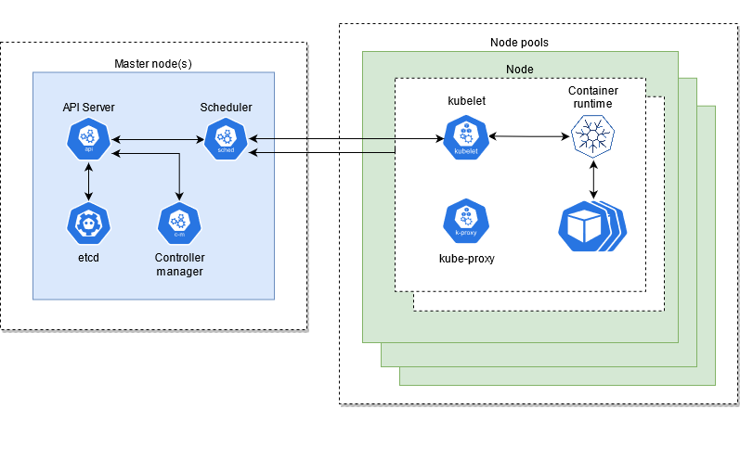
Azure Kubernetes Service Architecture (AKS)

Slide 31
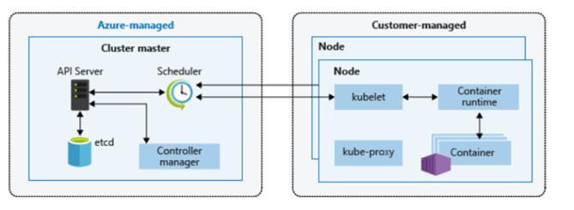
Azure Kubernetes Service Architecture (AKS)

Slide 32
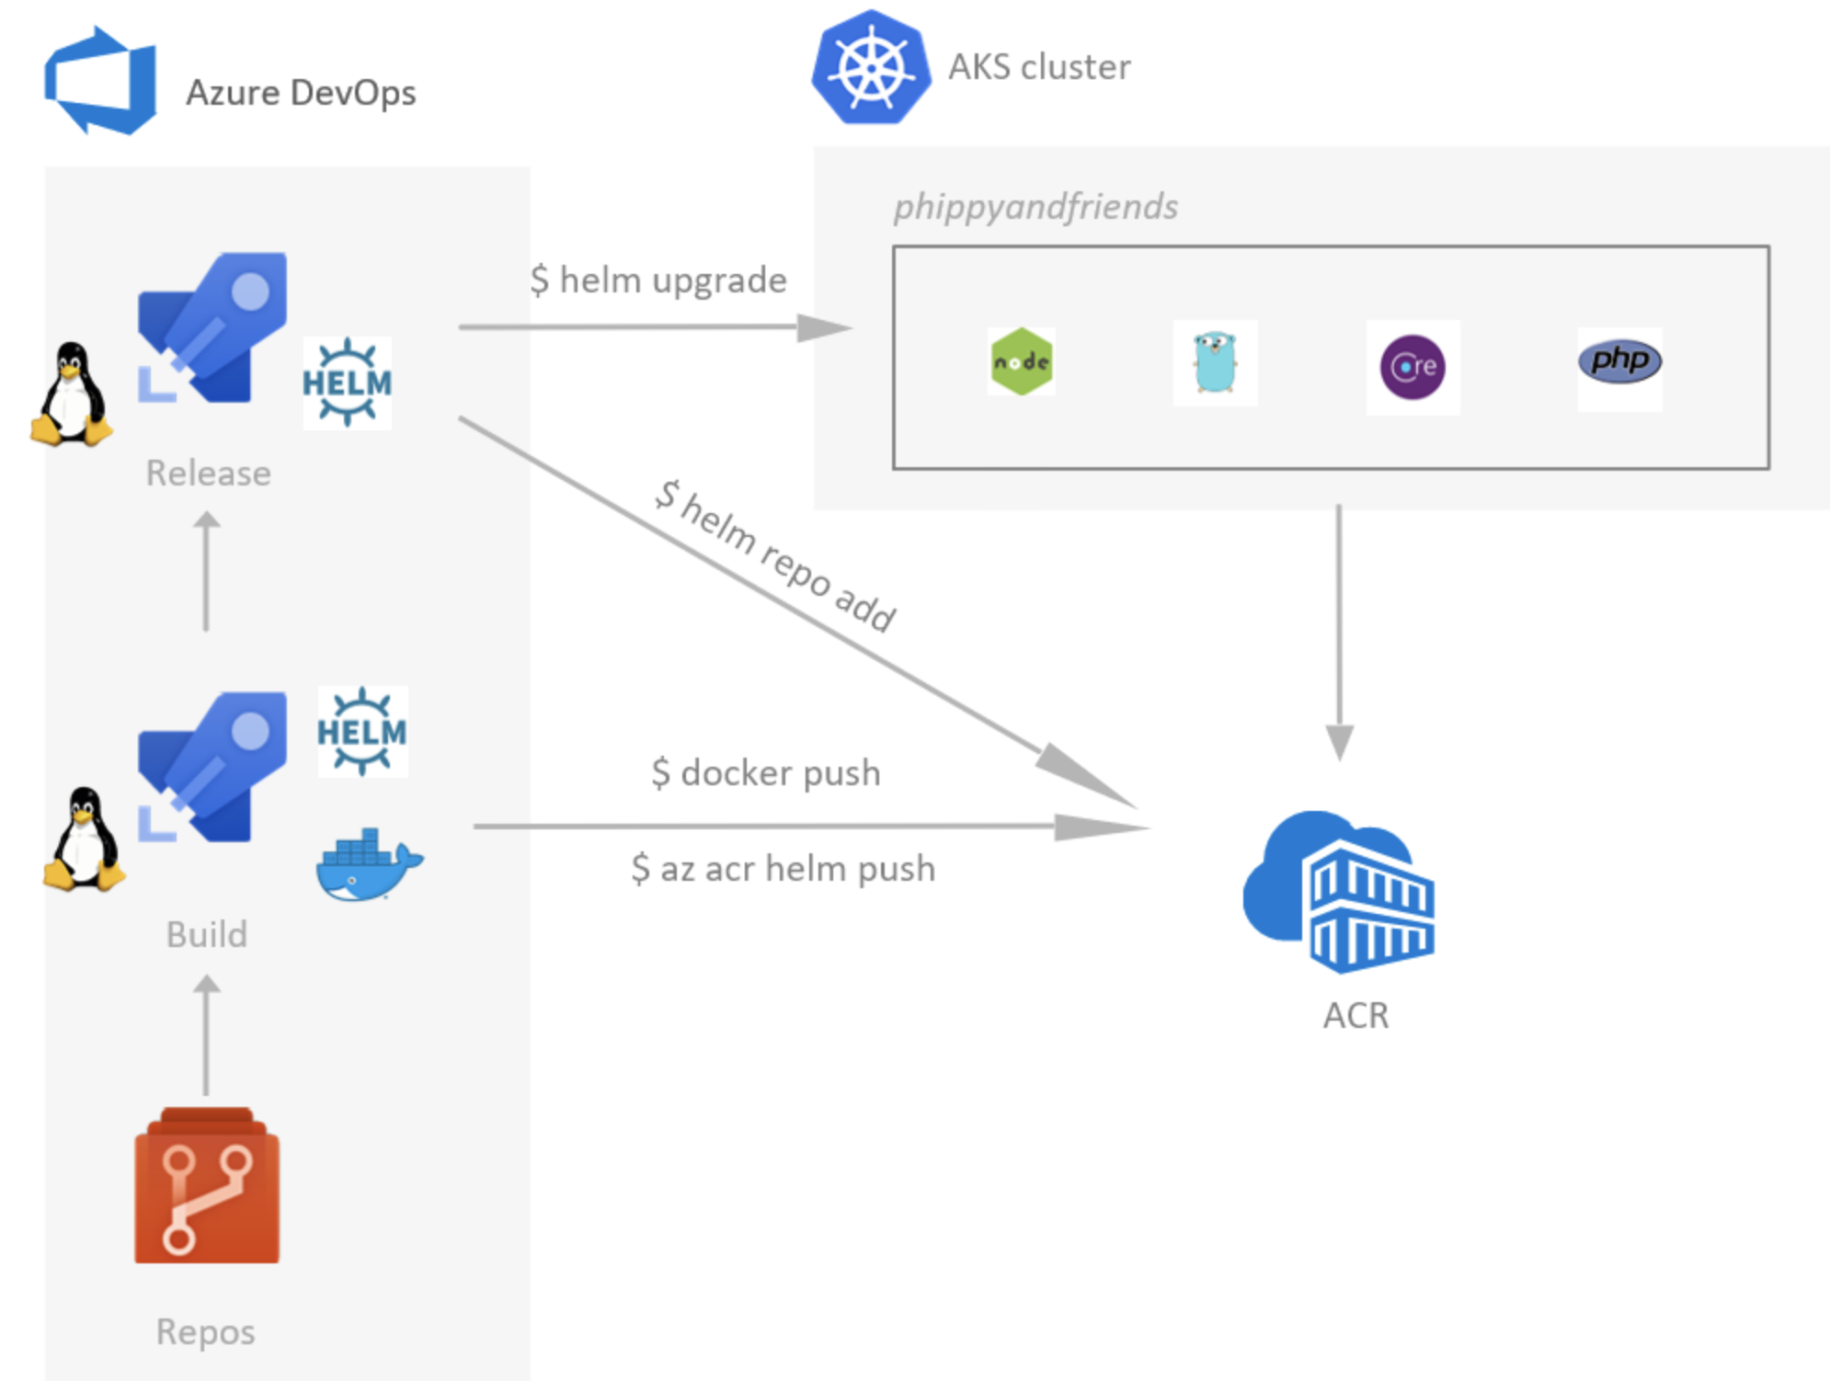
Azure DevOps for CICD to Azure Kubernetes Service (AKS)

Slide 33
Preferred solution
After evaluating the options for container platforms on Azure, Fabrikam Medical Conferences decided to move forward with Azure Kubernetes Service (AKS).
They also decided to move forward with GitHub Actions for infrastructure and container DevOps workflows.

Slide 34
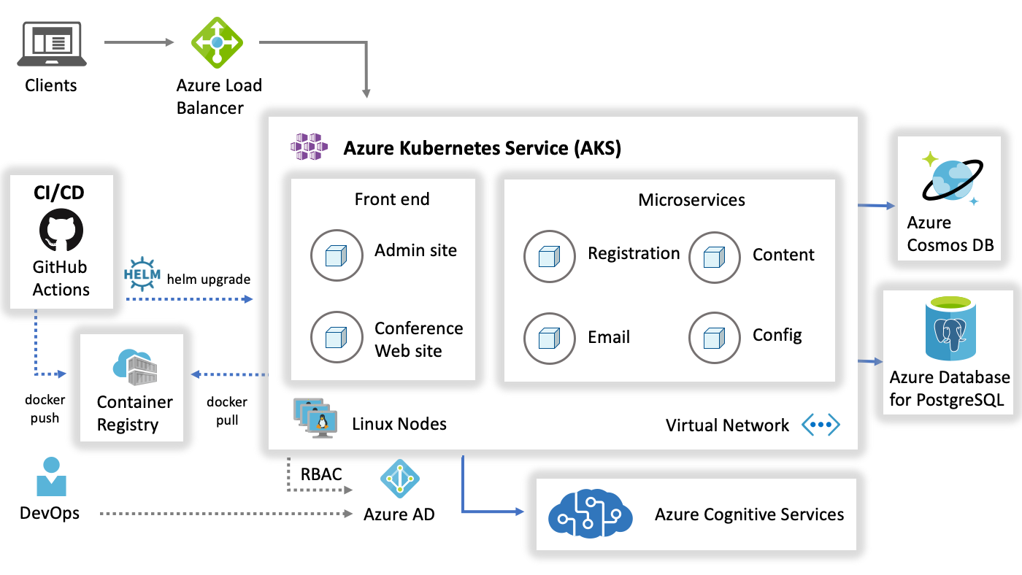
Preferred solution
Notes:
Reference Links:
https://docs.microsoft.com/en-us/azure/architecture/reference-architectures/microservices/aks

Slide 35
LAB – but first…

Slide 36
Environment https://bit.ly/3lsVU3o Code: ACTIVATE17607
* The lab is available for 8 hours from the start

Slide 37
NOTES

Slide 38
Do NOT just copy and paste the commands
Notes:
Take note of what you are doing!

Slide 39
Page 1-2 is information and ”set up”
Notes:
Take note of what you are doing!

Slide 40
”Build Agent VM” is NOT a Build Agent, but a development machine
Notes:
Take note of what you are doing!

Slide 41
Copy & Paste can be tricky Use Copy icon for copying command Use Ctrl + Shift + V to paste in shell
Notes:
Take note of what you are doing!

Slide 42
VI and VIM are hard, and even harder without ESC, use nano > nano app.js

Slide 43
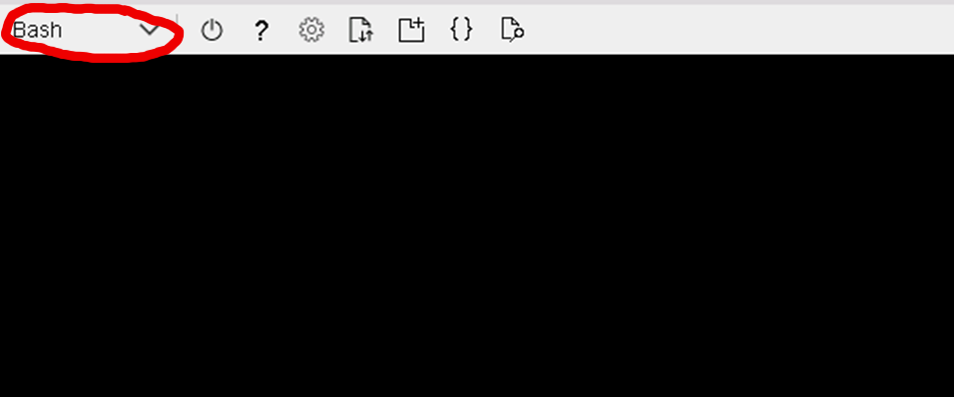
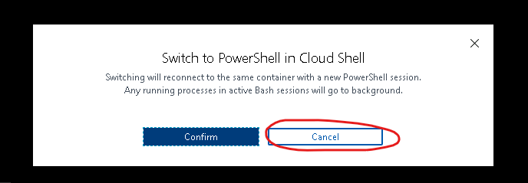
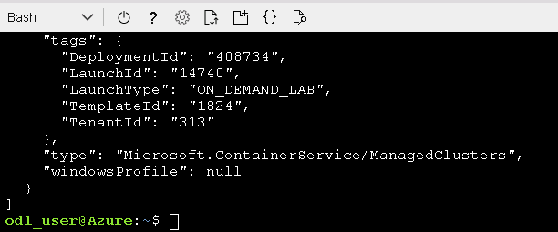

Slide 44
Page 3, Task 2, Step 8 is incorrect… Connection String is already correct

Slide 45
Page 6, Task 3, Step 11 is incorrect… Delete replicaset to cause redeploy

Slide 46
Adding Application Insights > npm i applicationinsights
"dependencies": { "applicationinsights": "^2.1.7", … }

Slide 47
Lab Validation Use the Lab Validation tab to verify that you are doing it right

Slide 48
We are here! Talk to us, ask us stuff, & let us know when you are done

Slide 49
LAB
Environment
URL https://bit.ly/3lsVU3o CODE ACTIVATE17607
Page 1-2
Paves the way for the lab
Copy-paste
Use copy icon to copy
CTRL+Shift+V to paste (in cloud shell/terminal)
Don’t waste time on vim
The browser hijacks your command shortcuts.
Use nano (on ”Build Agent VM”) and code on the other machine.
Page 3 > Task 3 > Step 8
Connection string already correct
Blank cloud shell?
Page 6 > Task 3 > Step 11
Delete existing replica-set to trigger re-deploy
Page 6 > Task 3 > Step 4
npm i applicationinsights
Edit package.json:
"dependencies": { "applicationinsights": "^2.1.7", … }

Slide 50
Q & A
Tobias Lolax tobias.lolax@activesolution.se
@tobibben
Chris Klug chris.klug@activesolution.se
@zerokoll

